Slide 1

Facial Emotion Recognition Research
Kossiyabek Aslan
Bissembayeva Indira
Aliyeva Assel

Slide 2

Problem
“When dealing with people, remember you are not dealing with creatures of logic, but with creatures of emotion.”
-Dale Carnegie
Notes:
Асель
Emotion recognition is a task, the solution of which can serve both for creating multimedia applications and games, and for more complex and demanded tasks, such as analyzing the mental and emotional state of people, efficiency discussions, negotiations, advertising, etc.
Human-computer interaction has been an important area of research. If a computer could understand the feelings of people, it could serve services based on the feedback it receives.

Slide 3
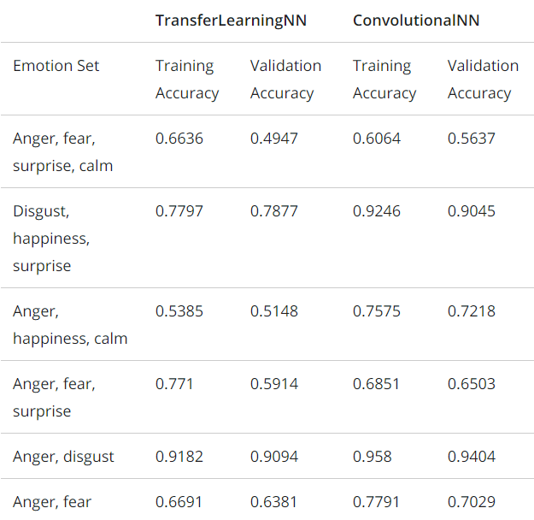
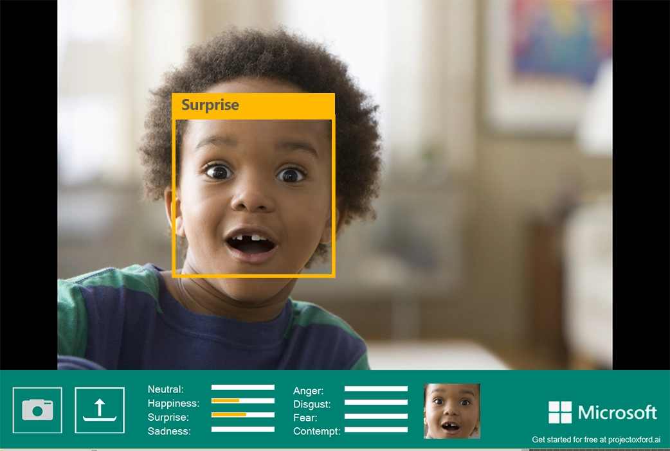
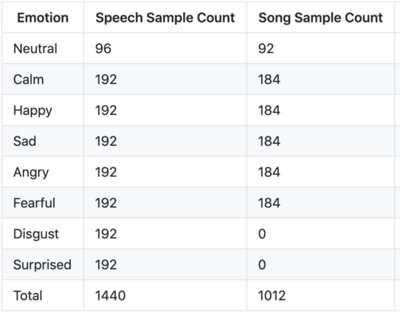
What has been done before us?
SER-project
Speech Emotion Recognition
Pre-trained emotion recognition models EmoPy
Microsoft Face Emotion Recognition
Dataset: RAVDESS (The Ryerson Audio Visual Database of Emotional Speech and Song)
Dataset: FER2013 and Cohn Kanade
Dataset: FER+
The new API can detect anger, contempt, disgust, fear, happiness, sadness, and surprise, as well as a neutral disposition
EmoPy is a python toolkit with deep neural net classes which predicts human emotional expression classifications given images of people's faces.
In the context of a dataset, there are two types of data: speech and song
Notes:
Индира

Slide 4
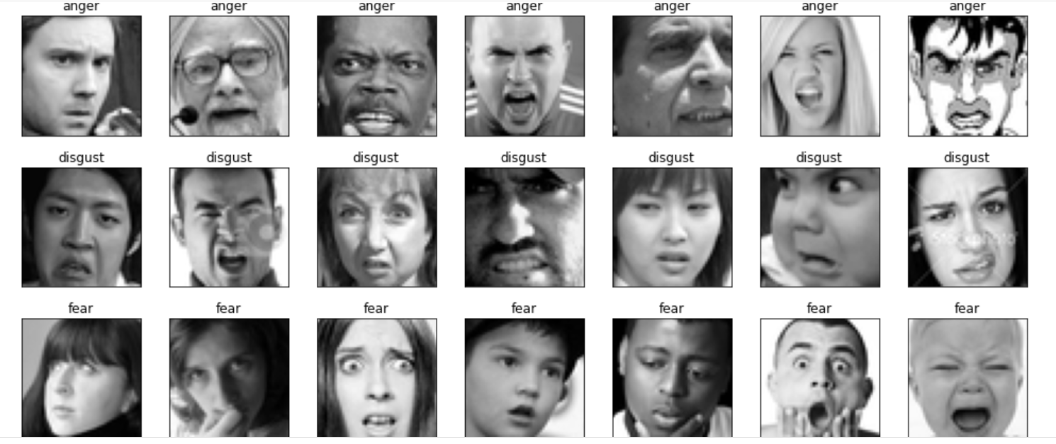
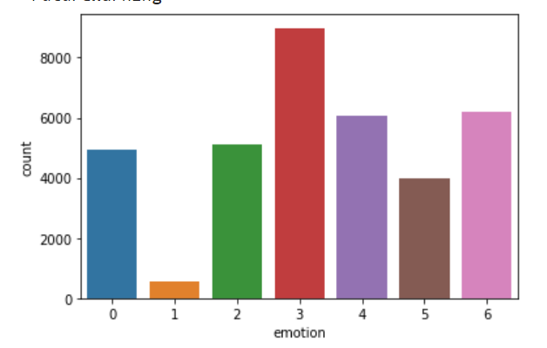
Dataset. FER2013
Contains 35,887 images with a resolution of 48x48 pixels.
Each image is classified into one of seven types of emotions: surprise, fear, happiness, anger, disgust, sadness, and neutral.
emotion_label_to_text = {0:'anger', 1:'disgust', 2:'fear', 3:'happiness', 4: 'sadness', 5: 'surprise', 6: 'neutral'}
Notes:
We can see that class happiness contains the highest number of images and class disgust the lowest.
Аслан

Slide 5
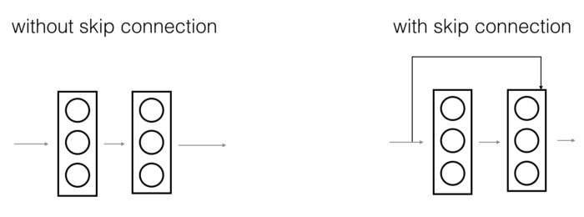
Algorithms
LRA (Logistic Regression Approach)
CNN (Convolutional Neural Network)
CNN (Convolutional Neural Network) with ResNet
Notes:
Индира

Slide 6
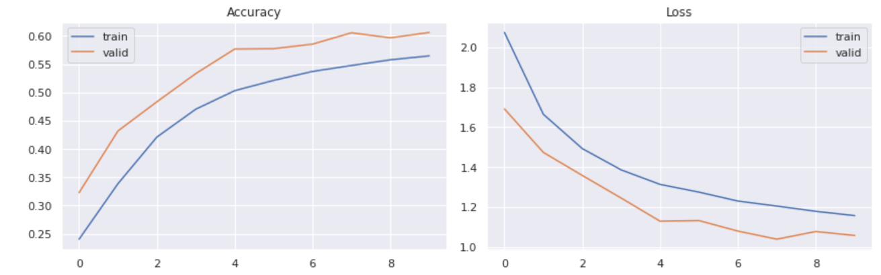
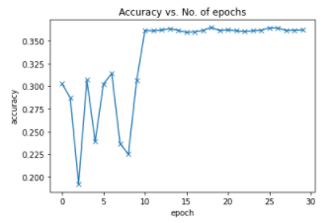
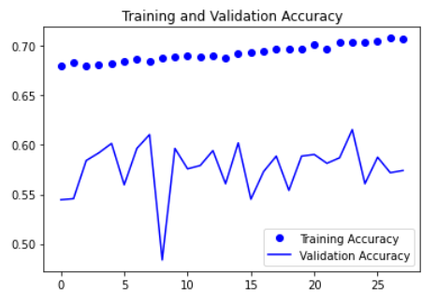
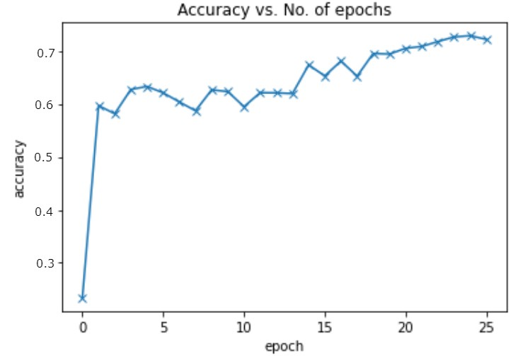
Accuracy
CNN
LRA
CNN with ResNet
Notes:
cnn with resnet поменять график
Аслан

Slide 7
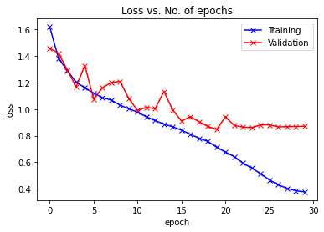
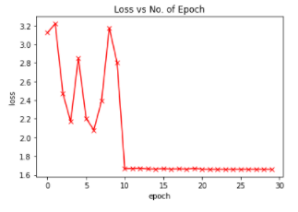
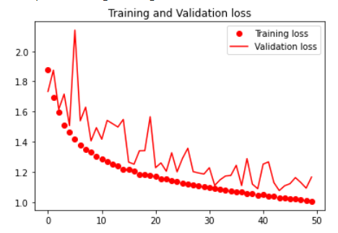
Loss
CNN
CNN with ResNet
LRA
Notes:
Аслан

Slide 8
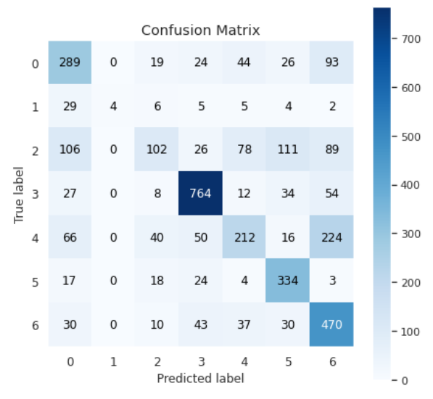
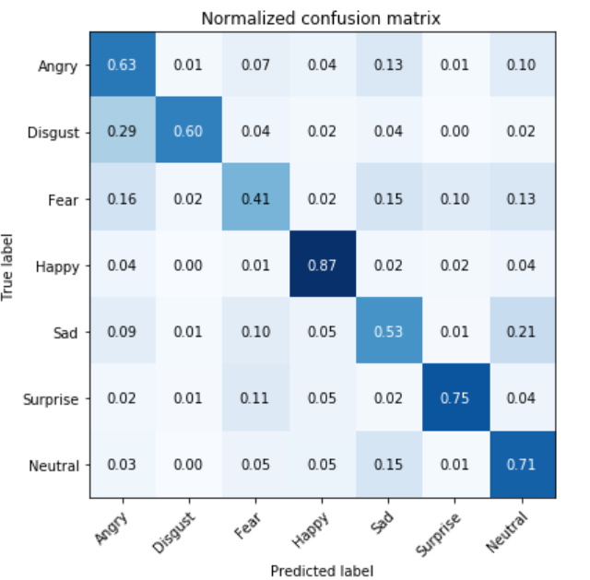
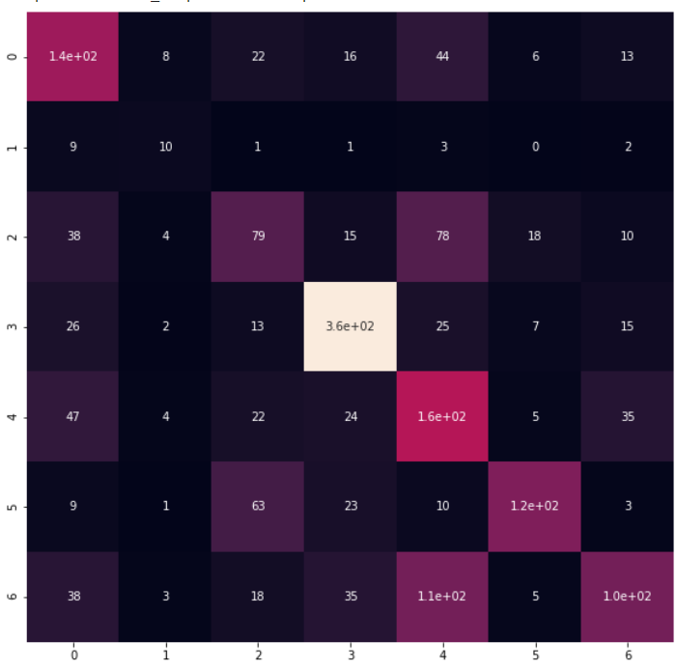
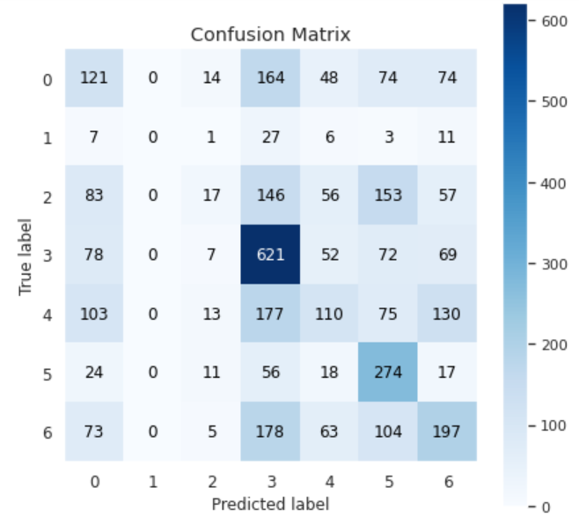
Confusion Matrix
CNN
LRA
CNN with ResNet
Notes:
Асель

Slide 9
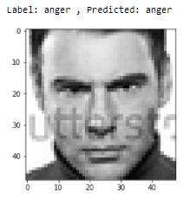
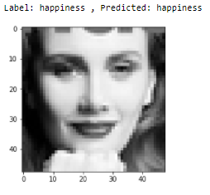
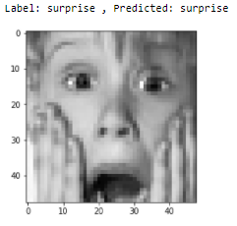
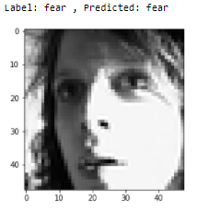
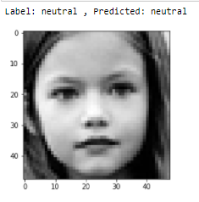
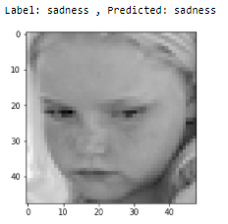
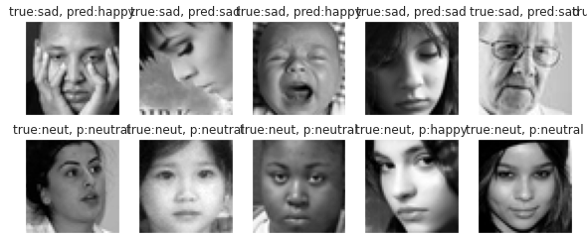
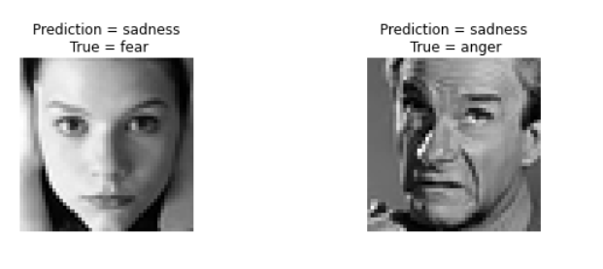
Output
Notes:
Асель

Slide 10
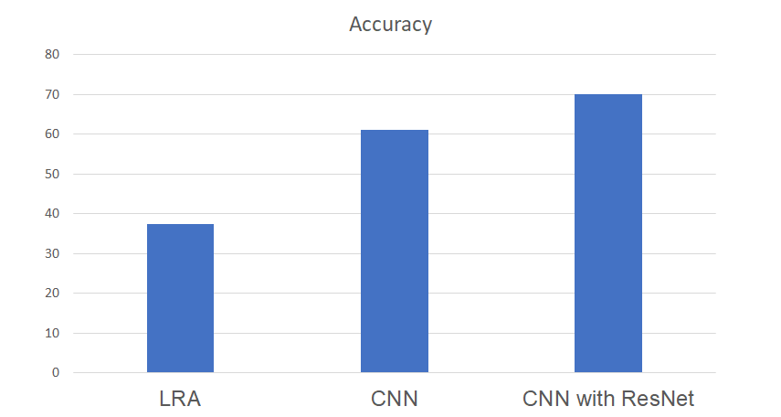
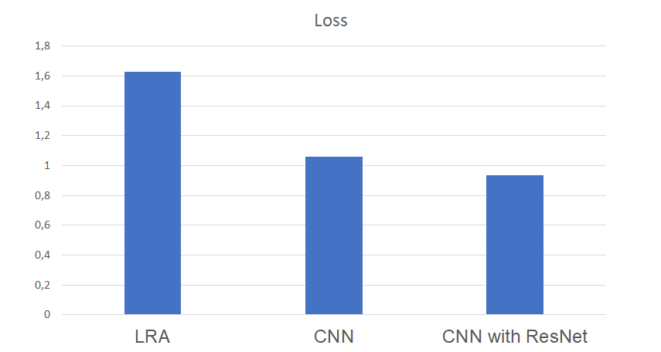
Conclusion
Algorithms | Accuracy | Loss
LRA | ≈ 37.5% | 1.62971
CNN | ≈ 61% | 1.0578
CNN with ResNet | ≈ 70% | 0.93374
As a result of the design of the neural networks and their subsequent training, the best obtained accuracy of the classification of emotions by the image of the face was about 70% - CNN with ResNet, because it has slight modification with additional step
Notes:
Аслан

Slide 11
Improvements
Adding more data in each class in order to get more accurate result as it is known that deep learning is a data-driven approach
Work with compound emotion classes such as surprised with happiness, surprised with anger, sadness with anger, surprised with sadness and so on
Use multi-layered models and image preprocessing ( face detection, alignment, rotation, resize, backlight, shadows, and facial incompleteness ) to increase accuracy of detection of face features and emotions
Train more databases into the system to make the model more and more accurate
Ensemble of neural networks and combine their predictive power
Notes:
Индира

Slide 12
Thank you for your attention!

Slide 13
Link to our code:
https://github.com/luikaaa27/Machine-Learning/Final_Project

